Slide 1
MEDTECH
Medicine Supply Chain Intelligence
A Data-Led Healthcare Strategy
GROUP : ARSHAD SELIYA & ABHIRUP DASS
PROJECT GUIDE: PRIYA SHANMUGAM
BATCH NO. DA644S64
COURSE NAME: DATA SCIENCE & ML WITH GEN AI

Slide 2
Problem Statement & Objectives
A leading healthcare provider experiences medicine unavailability, supply chain inefficiencies, and poor inventory management across 19 regions. The goal is to analyse demand, inventory, consumption, and supplier data to derive actionable insights.
Minimize Stockouts & Wastage
Enhance Supply Chain Reliability
Benchmark supplier lead times and delivery rates to reduce supply disruptions and procurement risks.
BO1
Reduce medicine unavailability and expiry losses to ensure uninterrupted patient care across 19 regions.
BO2
Procurement Cost Efficiency
Regional Demand Forecasting
Align unit costs with turnover rates to identify return losses and maximize profit margins.
Uncover regional consumption trends to enable proactive, data-driven procurement planning.
BO4
BO3

Slide 3
Dataset Overview
Consumption facility
Demand Sales
Inventory Stock
Supplier Procurement
11,111
14,218
841
538
records
records
records
records
13 columns
22 columns
22 columns
14 columns
Patient × Medicine
Daily consumption
Stockout by region
Wastage by region
Order level sales
Delivery returns
Profit & lead times
Medicine SKU level
Stock reorder levels
Expiry & Risk flags
Supplier reliability
Lead time & on time
Delivery KPIs
Total
26,708 unique patient/inventory/supplier records
19 Regions
5 Medicine Categories
538 Suppliers

Slide 4
Medicines Below Reorder Level by Category
BO1
Other (14)
Includes cardiac drugs, antibiotics, anaesthetics — critical
Parenteral (8)
Injectable ICU drugs running low — direct patient safety risk
Oral (4)
Below reorder, less critical than Parenteral in emergencies
Bulk/Raw (1)
Best managed — strong procurement planning demonstrated
Other category classification masks critical drugs like cardiac and inaesthetic medicines.
Parenteral has the highest rate of falling below reorder despite not having the highest absolute count, making it the most consistently under-stocked category.
27 of 841 medicines (3.2%) are below reorder level.
Targeted restocking especially for Parenteral and Other is operationally critical and directly tied to patient safety outcomes.
Notes:
Probability — P(Below Reorder Level) by Category
Parenteral (0.044) highest — 1 in 23 injectable medicines is below reorder at any given time, direct ICU risk.
Other (0.031) second — misclassified critical drugs hidden under generic label making detection slower.
Oral (0.022) third — manageable but needs monitoring.
Bulk/Raw (0.038) close to Parenteral — small category so even 1 item has high proportional impact.
Oral Liquid (0.000) best managed — no medicines below reorder.
Avg P(Below Reorder) = 0.032 — 3.2% of all 841 medicines are below reorder level at any time.
Chi-Square Statistic : 1.6637
P-Value: 0.7973
Degrees of Freedom: 4
Significance Level: 0.05
Result: FAIL TO REJECT H0
Medicines falling below reorder level is independent of category

Slide 5
Stock Status & Supply Gaps
BO1 | BO2
Top 5 Medicines with Highest Shortage Units
Stockout vs Overstock by Category
Drug Name | Category | Shortage Units
GLICLAZIDE 80MG + METFORMIN 500MG | Other | 39
MOXIFLOXACIN 400MG/100ML IV FLUID | Other | 51
SEVOFLURANE 99.97% | Other | 22
ASPIRIN 150MG | Other | 36
GLYCERYL TRINITRATE 5MG | Other | 22
Supplier KPI vs Shortage Count
Supplier | Avg Lead Days | Reliability | On-Time % | Shortage Count
Top 5 avg | ~11 | 4.5+ | 88%+ | Low
Bottom avg | ~12 | <3.5 | <75% | High
Overstocking dominates across all categories because facilities over-procure as a safety buffer, yet 27 medicines still fall below reorder meaning the problem is not total stock quantity but poor allocation.
Critical drugs under the 'Other' label go undetected longer because broad categorization delays targeted restocking decisions.
Supplier delays worsen this further when on-time delivery drops below 75%, replenishment arrives after stock is already critically low, making recovery reactive rather than preventive.

Slide 6
Regional Wastage & Stockout Patterns
BO1 | BO3
4,151
Total Wastage Units
across all regions
316
Stockout Events
(2.8% of records)
Mumbai
Highest Wastage (533)
& Stockout (80 days)
5×
Wastage probability
vs Stockout probability
Mumbai wastes 533 units and still stockouts for 80 days that paradox tells the whole story.
Every metro city shows the same pattern: bulk over-procurement creating waste, while critical medicines still run short.
Wastage is 5 times more probable than stockout but they're wasting the wrong medicines and running out of the right ones.
This is a misallocation problem, not a supply problem.
Notes:
P(Stockout | Wastage=1) = 0.935
P(Wastage) = 0.144 P(Stockout) = 0.028
Avg P(Wastage) = 0.144 5x higher than stockout probability (0.028)
Avg P(Stockout) = 0.028 3% of all medicine records face stockout risk.
Chi-Square: Region vs Stockout_Flag
χ² = 20.11,
p = 0.3265,
DOF = 18 → FAIL TO REJECT H0
Stockout is independent of region
Chi-Square: Wastage_Flag vs Stockout_Flag
χ² = 1941.85,
p ≈ 0.0000,
DOF = 1 → REJECT H0
Wastage and stockout are strongly related

Slide 7
Inventory Risk Distribution
BO1 | BO4
176
Overstock Items
(48.1%)
168
Expiry Risk Items
(45.9%)
22
Stockout Risk
(6.0%)
841
Total Inventory
Items
Overstock (48%) + Expiry Risk (46%) dominate inventory risk 94% of flagged items represent excess or expiring stock.
Only 6% are true shortages.
Poor demand forecasting is the root cause: too much of the wrong stock, too little of the right stock.
This directly drives financial loss through wastage and capital lock-up.
Notes:
Percentages shown as proportion of all 841 inventory items. Flagged items may overlap.

Slide 8
Supplier Performance & Reliability
BO2
4.29/5
82.1%
8 days
20%
Avg Reliability
Score
Avg On-Time
Delivery Rate
Avg Lead
Time
Poor-Performance
Suppliers
Top Reliable Suppliers
Bottom Reliable Suppliers
Supplier_137
Supplier_46
On-Time: 95% | Avg Lead: 14d | Score: 5.0/5
On-Time: 73% | Avg Lead: 8d | Score: 3.5 / 5
Supplier_417
Supplier_472
On-Time: 94% | Avg Lead: 14d | Score: 5.0/5
On-Time: 75% | Avg Lead: 7d | Score: 3.5 / 5
Supplier_455
Supplier_184
On-Time: 94% | Avg Lead: 14d | Score: 5.0/5
On-Time: 76% | Avg Lead: 14d | Score: 3.5 / 5
1 in 5 suppliers (20%) performs poorly, a significant reliability gap across the procurement network.
Chennai (24.2%), Delhi (23.4%) and Mumbai (22.7%) carry the highest poor-performance probability despite being primary supplier hubs, they present the greatest delivery risk.
High-volume procurement from metros comes with overburdened suppliers who take on more orders than they can reliably fulfill.
Lucknow is the best-performing region (12.5%) procurement should prioritize suppliers from lower-risk regions where possible.
High-reliability suppliers (score 5.0) achieve up to 95% on-time delivery.
Notes:
Chennai (0.242) highest poor performance - 1 in 4 suppliers underperform.
Delhi (0.236) & Mumbai (0.228) follow - metro city suppliers surprisingly unreliable.
Lucknow (0.125)best performing - lowest poor performance probability.
Avg P(Poor Performance) = 0.200 - 20% of all suppliers perform poorly.

Slide 9
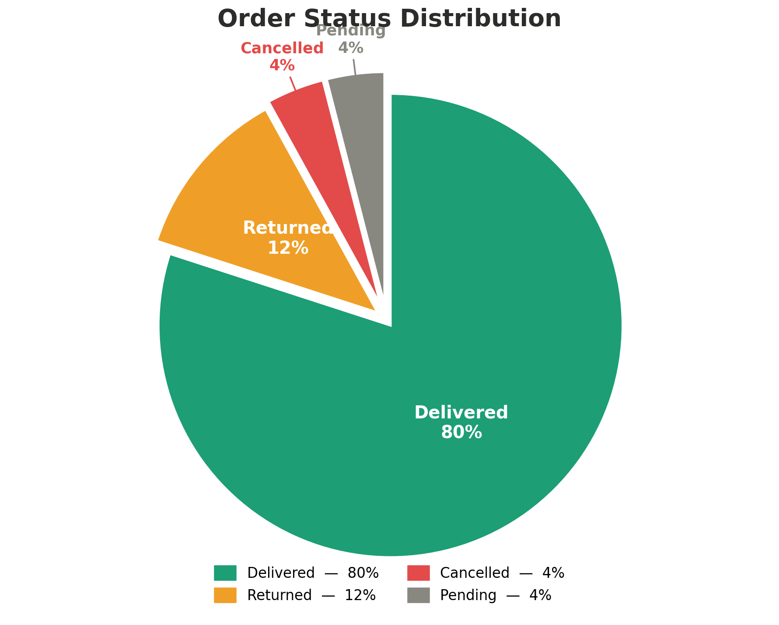
Demand Trends & Order Outcomes
BO3 | BO4
Demand peaks Jul–Sep due to seasonal illness cycles and crashes in Mar, Apr & Oct from budget resets predictable enough to plan procurement proactively rather than reactively.
The 11.8% return rate likely stems from over-ordering during peaks and expiry-driven returns, directly eroding the ₹63.8 avg profit.
Better demand forecasting and formulation alignment can fix both.

Slide 10
Return Loss & Procurement Profit Efficiency
BO4
₹9.5L
₹18.6L
Total Procurement
Cost
Total Sales
Value
₹101
18.8×
Avg Unit Cost
(Supplier)
Avg Inventory
Turnover Rate
26 days
1,681
Median Stock
Cover Days
Total Return
Orders
All returns generate losses even 1 unit returned causes ₹96 loss.
2-unit returns create the steepest per-return loss at ₹147.59, likely involving high-cost medicines.
Avg inventory turnover of 18.8× suggests reasonable stock movement, but median stock cover of 26 days leaves little buffer for supply disruptions.
Unit costs range ₹5.16–₹199.88 with avg ₹101.10 high variance indicates procurement strategy inconsistency across drug categories.
Notes:
Why 2-unit returns cause the highest loss The 2-unit return bin likely captures a specific set of high-value medicines (e.g., specialty injectables, branded drugs) where even 2 units returned = large revenue loss. Bulk returns (10–50 units) in contrast are likely cheaper generics or OTC drugs.
T-Statistic : -27.7046
P-Value : 0.0000
Significance Level : 0.05
Result: REJECT H0
Returned orders have significantly lower profit than delivered orders

Slide 11
Automation & Database
BO1 | BO2
AUTOMATIONS IMPLEMENTED
EVIDENCE: SAMPLE QUERY OUTPUTS
Stored Procedure: reorder_medicines()
Identifies medicines where Current_Stock < Reorder_Level
Returns top 5 critical reorder candidates on demand
Invoked via: CALL reorder_medicines();
CALL reorder_medicines() — Top Results
Medicine_ID | DrugName | Stock | Reorder
M07208F17 | LIGNOCAINE HYDROCHLORIDE 2% INJ | 2 | 35
M09598F70 | ADRENALINE INJ 1ML | 78 | 87
27 of 841 medicines flagged for urgent reorder
Trigger: low_stock_trigger (BEFORE UPDATE)
Fires automatically on every stock update event
Sets Stock_Status = Low Stock if stock falls below Min_Required
Real-time flag update — zero manual intervention
Trigger Verification — M07208F17
After UPDATE Current_Stock = 5 (Min_Required = 30):
Medicine_ID | DrugName | Current_Stock | Stock_Status
M07208F17 | | LIGNOCAINE HYDROCHLORIDE 2% INJ | 5 | Low Stock
Status auto-set instantly on stock write
Event Scheduler: auto_low_stock_check
Scheduled MySQL event runs every 1 MINUTE automatically
Refreshes Stock_Status across all 841 medicines — no cron needed
Enabled via: SET GLOBAL event_scheduler = ON
SHOW EVENTS — Scheduler Confirmation
Event Name | Status | Interval
auto_low_stock_check | ENABLED | 1 MINUTE
Post 1-min: all Stock_Status rows auto-refreshed
Zero-downtime continuous monitoring confirmed
Cross-Table JOIN Queries (5 Analyses)
Demand + Consumption (Patient_ID) — order-to-usage tracing
Demand + Inventory (DrugName) — stock vs demand gap check
Supplier + Inventory (Vendor_ID) — KPI vs shortage link
Supplier KPI vs Shortage — JOIN Output
Supplier | Reliability | On-Time% | Shortages
Supplier_219 | 4.6 | 91% | 2
Supplier_1 | 4.2 | 75% | 1
Low reliability directly linked to higher shortage count

Slide 12
Statistical Summary
HYPOTHESIS TESTS
PROBABILITY FINDINGS
Test 1: Region vs Stockout Flag
Chi² = 20.11 | p = 0.3265 | DOF = 18
FAIL TO REJECT H0
Stockout is independent of region
Regional Stockout Probability
Highest: Coimbatore (0.043) — Lowest: Surat (0.011)
Worst Wastage: Kanpur (0.174)
Parenteral: Stockout Risk=0.039, Expiry Risk=0.923
Test 2: Wastage Flag vs Stockout Flag
Chi² = 1941.85 | p ≈ 0.0000 | DOF = 1
REJECT H0
Wastage and stockout are strongly related
Stockout & Wastage Probability
Avg P(Stockout) = 0.028 — 3% of all medicine records
Avg P(Wastage) = 0.144 — 5x higher than stockout
P(Stockout | Wastage=1) = 0.935
P(Below Reorder Level) by Category
Avg P(Below Reorder) = 0.032 — 3.2% of 841 medicines
Parenteral (0.044) — highest, direct ICU risk
Bulk/Raw (0.038) | Other (0.031) | Oral (0.022)
Oral Liquid (0.000) — best managed
Test 3: Daily Consumption vs Stockout
T = 1.0816 | p = 0.2795 | α = 0.05
FAIL TO REJECT H0
Consumption not significantly different by stockout status
Test 4: Returned Orders vs Profit
T = -27.7046 | p = 0.0000 | α = 0.05
REJECT H0
Returned orders have significantly lower profit
Supplier Poor Performance
Avg P(Poor Supplier) = 0.200 — 1 in 5 underperform
Worst: Chennai (0.242) | Best: Lucknow (0.125)
Delhi (0.236) & Mumbai (0.228) also high-risk metros
Test 5: Category vs Below Reorder Level
Chi² = 1.6637 | p = 0.7973 | DOF = 4
FAIL TO REJECT H0 — Reorder level independent of category
Notes:
Test 1 — Region vs Stockout
H0: Stockout rate is equal across all regions
H1: Stockout rate differs significantly by region
Test 2 — Wastage vs Stockout
H0: Wastage has no relationship with Stockout
H1: Wastage and Stockout are significantly related
Test 3 — Consumption vs Stockout
H0: Daily consumption is equal for stockout vs non-stockout records
H1: Daily consumption differs significantly
Test 4 — Returned Orders vs Profit
H0: Profit is equal across returned and delivered orders
H1: Returned orders have significantly lower profit
Test 5 — Category vs Reorder Level
H0: Falling below reorder level is independent of category
H1: Medicines falling below reorder level differs significantly by category

Slide 13
Machine Learning: Consumption Prediction – Linear Regression & KNN Regressor
BO2
BO4
Both Models — Same Features (X): Stockout_Flag | Wastage_Rate | Daily_Consumption_Units | Bed_Days | Wastage_Flag Target (y): Total_Consumption | Split: 80/20
LINEAR REGRESSION — Consumption Prediction
KNN REGRESSOR — Consumption Prediction (K=5)
MODEL COMPARISON
R²
0.55
MAE
1.75
MSE
36.58
R²
0.80
MAE
0.28
MSE
15.60
Metric | Linear Reg | KNN (K=5)
R² Score | 0.55 | 0.80 ✓
MAE | 1.75 | 0.28 ✓
MSE | 36.58 | 15.60 ✓
ICU Cases | Underestimates | Handles Better
Model underestimates high-consumption (ICU) cases
95%+ predictions within ±10 units — reliable for routine planning
Linear assumption limits accuracy for complex demand interactions
Key drivers: Daily Consumption Units, Bed Days & Wastage Rate
R²=0.55: remaining 45% variance from ICU outliers & patient-level variability not in features
Finds 5 most similar historical records to predict consumption
R²=0.80: explains 80% of variance — significantly stronger than LR
MAE=0.28 — predictions off by less than 1 unit on average
Captures non-linear patterns across drug types, wastage & patient stay
Key drivers: Daily Consumption Units, Bed Days & Wastage Flag
✅ PREFERRED MODEL — KNN Regressor (K=5)
25% higher R² (0.80 vs 0.55) across same features & split
6× lower MAE (0.28 vs 1.75) — reliable for daily stock planning
MSE reduced by 57% — far fewer large prediction errors
Supports BO2: accurate Total Consumption forecasts per drug & facility
Insight: Stockout_Flag & Wastage_Rate interactions drive errors — a non-linear model is needed for ICU-level accuracy.
Insight: KNN's pattern-matching naturally handles binary + continuous feature mix — medicine demand is non-linear by nature.
KNN outperforms Linear Regression across all 3 error metrics using identical 5 features and 80/20 data split.
Linear Regression's linear assumption fails for medicine consumption — demand varies non-linearly by drug type, patient profile and wastage behaviour.
For ICU/critical care medicines, both models need additional features (diagnosis type, department) to further improve prediction accuracy.

Slide 14
Machine Learning: Stockout Classification — Logistic Regression
BO2
BO4
LOGISTIC REGRESSION — Stockout Risk Prediction (Binary Classification | class_weight='balanced' | max_iter=1000)
Features (X): Wastage_Flag | Daily_Consumption_Units | Wastage_Units | Bed_Days Target (y): Stockout_Flag | Split: 80/20 | Stratified | Scaler: StandardScaler
88%
1.00
0.20
0.33
0.9881
Accuracy
Recall (Stockout)
Precision
F1 Score
ROC-AUC
Confusion Matrix
Model Observations
ROC-AUC Score
Pred: No Stockout
Pred: Stockout
Accuracy = 88%
Correctly classifies 88% of all records overall.
Recall = 1.00 (Stockout)
Never misses a real stockout — CRITICAL for patient safety.
Precision = 0.20
80% false alarms — acceptable trade-off; missing a stockout is far more dangerous.
Class Imbalance: 63 stockout vs 2,160 non-stockout (97:3 ratio).
0.9881
Act: No Stockout
TN = 1,900
FP = 260
98.81% ability to distinguish
Stockout vs No Stockout
Act: Stockout
FN = 0 ✓
TP = 63
AUC = 0.9881
Curve hugs top-left corner — far above random classifier. Reliable for prioritising restocking.
FN = 0 ✓ Model missed ZERO real stockouts — medically safe. No patient was at risk due to missed prediction.
FP = 260 260 false alarms raised — staff investigate unnecessarily. Acceptable: missing a stockout is far more dangerous.
Wastage_Flag = 1 is the strongest predictor — Record 2 (wastage + high consumption + long stay) carries 93.5% stockout probability.
Key Insight: HIGH RECALL > Precision in healthcare — better to over-alert than miss a real stockout that impacts patient care.

Slide 15
Machine Learning: Stockout Classification — KNN Classifier
BO2
BO4
KNN CLASSIFIER — Stockout Risk Prediction (K=3 | weights='distance' | metric='euclidean')
Features (X): Wastage_Flag | Daily_Consumption_Units | Wastage_Units | Bed_Days Target (y): Stockout_Flag | Split: 80/20 | Stratified | Scaler: MinMaxScaler | Optimal K selected via error rate (K=1 to 30)
99%
0.76
0.87
0.86
0.9361
Accuracy
Recall (Stockout)
Precision
F1 Score
ROC-AUC
Confusion Matrix
Model Observations
ROC-AUC Score
Pred: No Stockout
Pred: Stockout
Accuracy = 99%
Correctly classifies 99% of records — excellent overall accuracy.
Recall = 0.76 (Stockout)
Misses 15 actual stockouts (FN=15) — unacceptable in healthcare context.
F1 Score = 0.86
Strong precision-recall balance for non-critical procurement planning.
FP = 7 only — very few false alarms raised vs LR's 260.
0.9361
Act: No Stockout
TN = 2,153
FP = 7
93.61% ability to distinguish
Stockout vs No Stockout
Act: Stockout
FN = 15 ⚠
TP = 48
AUC = 0.9361
Strong discrimination — but lower than Logistic Regression's 0.9881 AUC.
✅ PREFERRED: Logistic Regression — Recall=1.00 & AUC=0.9881 vs KNN Recall=0.76 & AUC=0.9361
LR catches 100% of stockouts (FN=0) vs KNN which misses 15 (FN=15) — in healthcare, each missed stockout risks patient safety.
KNN's 99% accuracy is misleading with a 97:3 class imbalance — Recall is the critical metric, not accuracy.
Wastage_Flag = 1 is the strongest trigger in both models — any medicine showing wastage should trigger immediate inventory review (BO4).

Slide 16
KMeans Clustering: Supplier Performance Segments
BO2
BO4
Supplier Segmentation by Efficiency Score & Delivery Gap
130
Suppliers
Efficiency: 21.85 | Gap: 4 days
HIGH PERFORMANCE
190
Suppliers
Efficiency: 11.25 | Gap: 7 days
MODERATE PERFORMANCE
218
Suppliers
Efficiency: 6.96 | Gap: 12 days
LOW PERFORMANCE
C1 — High Performance Suppliers
C0 — Moderate Performance Suppliers
C2 — Low Performance Suppliers
High efficiency score, low delivery gap.
Preferred vendors for critical medicine procurement.
Maintain & strengthen contracts.
Average efficiency, moderate delivery gap.
Suitable for routine procurement needs.
Monitor KPIs & push for lead time improvement.
Low efficiency score, high delivery gap.
High risk to supply chain continuity.
Reduce dependency or replace these vendors.
Cluster 1 - High performance suppliers, (130 records, Efficiency=21.85) are preferred vendors — maintain & strengthen contracts for critical medicines.
Cluster 2 - Low Performance suppliers, (218 records, Delivery Gap=12 days) poses the highest supply chain risk — reduce dependency or replace.
Cluster 0 - Moderate performance suppliers (190 records) are suitable for routine procurement but require KPI monitoring and lead time improvement.

Slide 17
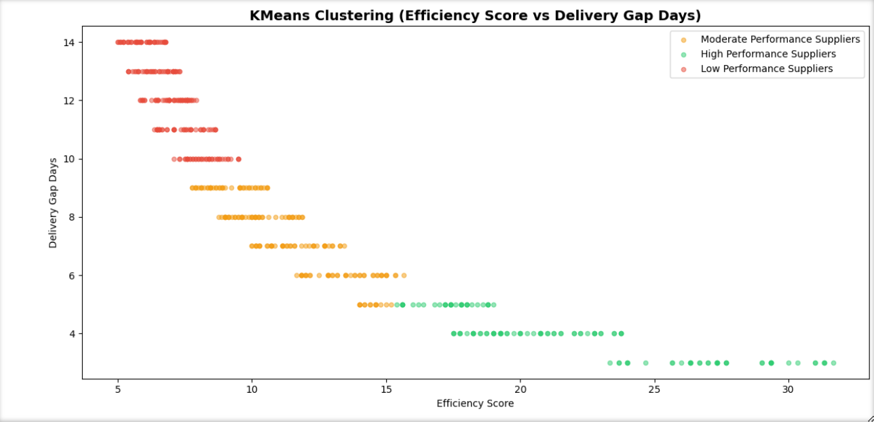

Slide 18
Business Recommendations
BO1 & BO2
R1
Implement Dynamic Reorder Triggers
27 of 841 medicines (3.2%) are below reorder level deploy automated reorder triggers (already built) across all 19 facilities.
Prioritize Parenteral medicines first, where stockout probability is 0.044, the highest of all categories and a direct ICU patient safety risk.
Impact: Reduce stockout incidents | Prevent expiry waste
BO1
R2
Reclassify 'Other' Category
14 of 27 below-reorder medicines are hidden under 'Other', masking cardiac drugs, antibiotics, and anaesthetics from targeted alerts.
Reclassifying enables category-specific procurement decisions and faster restocking response for critical drugs.
Impact: Improve visibility | Enable targeted restocking
BO1
R3
Prioritise High-Reliability Suppliers
Redirect procurement to Supplier_137 (95% on-time), Supplier_417 (94%), and Supplier_455 (94%), all scoring 5.0 reliability with 14-day avg lead times.
Reduce dependency on Chennai (0.242 poor performance) and Delhi (0.236) supplier pools which carry the highest delivery risk.
Impact: Reduce 33% delay-risk supplier exposure
BO2
R4
Introduce Supplier Scorecard & SLA Enforcement
20% of all 538 suppliers perform poorly, with on-time delivery below 75% directly correlated with high shortage counts.
Enforce minimum standards of 88% on-time delivery and reliability ≥ 4.0 to eliminate the bottom-performing supplier tier.
Impact: Improve supply reliability | Reduce shortages
BO2

Slide 19
Business Recommendations
BO3 & BO4
R5
Deploy Seasonal Demand Planning for Jul–Sep Peak
Monthly demand spikes to 2,800–3,000 units in July–September versus just 700 units in March, April, and October, a predictable 4x swing.
Pre-positioning inventory before peak months eliminates reactive emergency procurement and reduces stockout risk during surges.
Impact: Reduce emergency orders | Optimise stock timing
BO3
R6
Target High Wastage Probability Regions (Mumbai, Delhi, Coimbatore)
Mumbai alone recorded 533 wastage units and 80 stockout days simultaneously proving misallocation, not shortage, is the core problem.
Deploy the ML stockout classifier (AUC = 0.99) at facility level to generate daily risk alerts, using wastage as the primary early warning signal.
Impact: Reduce 14.4% avg wastage rate regionally
BO3
R7
Minimise Return Orders : Focus on 2-Unit Returns
All 1,681 return orders generate losses, 2-unit returns cause the steepest loss at ₹147.59 per order, likely driven by high-value specialty injectables.
Investigating and reducing high-cost drug return patterns can directly recover profit currently being lost across returned orders.
Impact: Direct profit recovery from return reduction
BO4
R8
Standardise Procurement Costs : Address Unit Cost Variability
Unit costs range from ₹5.16 to ₹199.88 with average ₹101.10, high variance indicates inconsistent vendor pricing across drug categories.
Median stock cover is only 26 days, extending this to 35+ days provides a meaningful buffer against the 8-day average supplier lead time and seasonal demand spikes.
Impact: Reduce unit cost variance | Improve budget certainty
BO4

Slide 20
Summary & Conclusion
BO
BO2
BO3
BO4
Overall Message
This healthcare provider is not facing a shortage crisis - it is facing a misallocation crisis.
Too much of the wrong medicines are stocked, while the right critical medicines run short.
Poor demand forecasting, inconsistent supplier reliability, and unmanaged return losses are eroding financial performance.
The data makes clear that supply chain efficiency gains are achievable without new capital investment through better data-driven inventory triggers, targeted supplier management, and seasonal procurement planning.

Slide 21
THANK YOU

